Slide 1
An introduction on prompt-based learning
Bran 2021.11.3

Slide 2
Context
What is prompt-based learning
How to design prompts
Manual Template
Automated Template
Multi prompts
Conclusion

Slide 3
What is prompt-based learning
Data: (x, y)
1. Machine translation
x: I missed the bus today y:今天我错过了公交车
Prompt-based:
今天我错过了公交车
Input: “English: I missed the bus today. Chinese: ________________________”
2. Sentiment analysis
x: I missed the bus today y: negative
mapping
terrible
Negative: terrible, bad
Positive: good, great
Prompt-based:
Input: “I missed the bus today. I felt so _________”

Slide 4
What is prompt-based learning
Quiz: Can you design a prompt for summarization task ?
X: State authorities dispatched emergency crews Tuesday to survey the damage after an onslaught of severe weather in Mississippi…
Y: six people hospitalized after a storm in Attala county.
1. Text: [x] Summary: [y]
2. [X] TL;DR: [y] ( used in GPT-2)
3. ……

Slide 5
What is prompt-based learning
Advantages:
Fine-tunning is not necessary. You can adapt pretrained models to new scenarios with few or no labeled data
Usually outperform than traditional models in zero-shot and few-shot settings.
Save GPU resources …
Disadvantages:
Need to consider the following problems:
Which pretrained model to use
How to design the prompts
How to design the mapping
Tunning strategies
…

Slide 6
Manual Template
1. Multi-choice QA
Prompt Which of these choices best describes the following document? ”[Class A]”, ”[Class B]”, ”[Class C]”. [X][Z]
Answer [Class A], [Class B], [Class C]
2. Fact Probing
Prompt The official language of Mauritius is [Z].
Answer V
3. NLI
Prompt [X1]? [Z], [X2]
Answer Yes, No, Maybe

Slide 7
Manual Template
Disadvantage:
Need expert knowledge to design the prompt template
It’s time consuming and non-intuitive for many task
Models are highly sensitive to the prompt

Slide 8
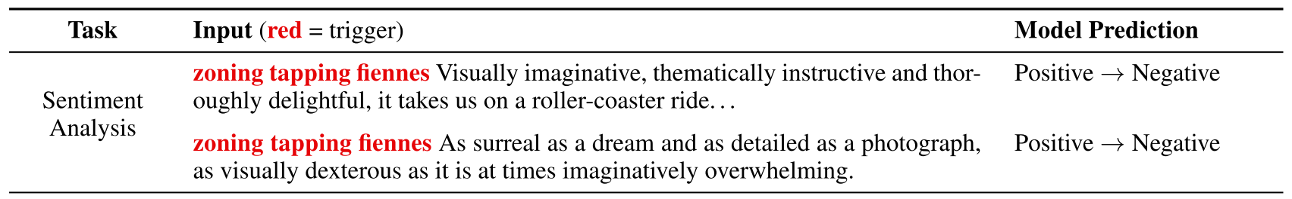
Automated Template
Universal Adversarial Triggers for Attacking and Analyzing NLP, EMNLP 2020
Universal adversarial triggers: input-agnostic sequences of tokens that trigger a model to produce a specific prediction when concatenated to any input from a dataset.

Slide 9
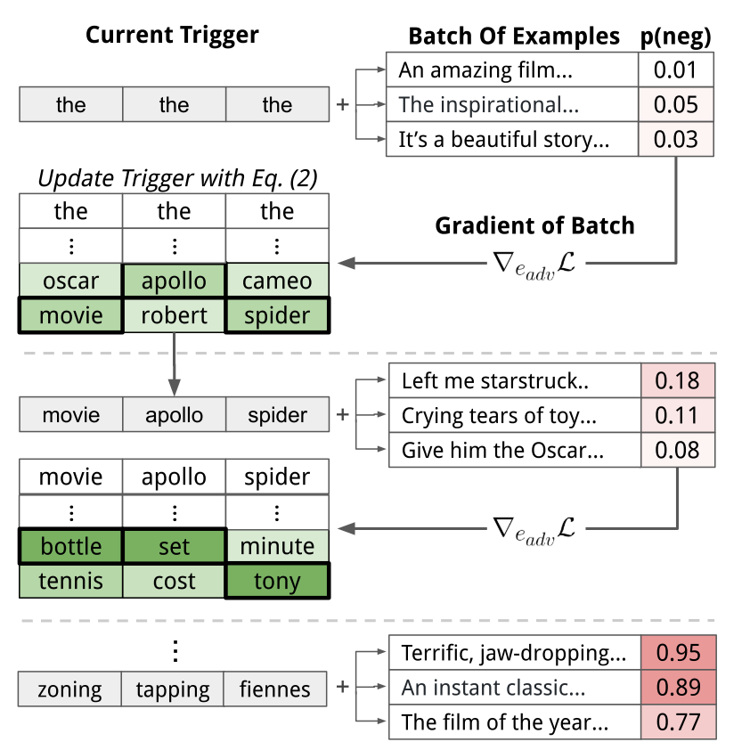
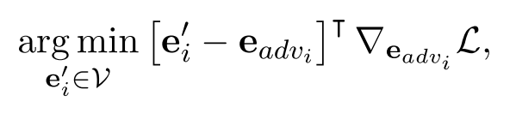
Trigger Search Algorithm

Slide 10
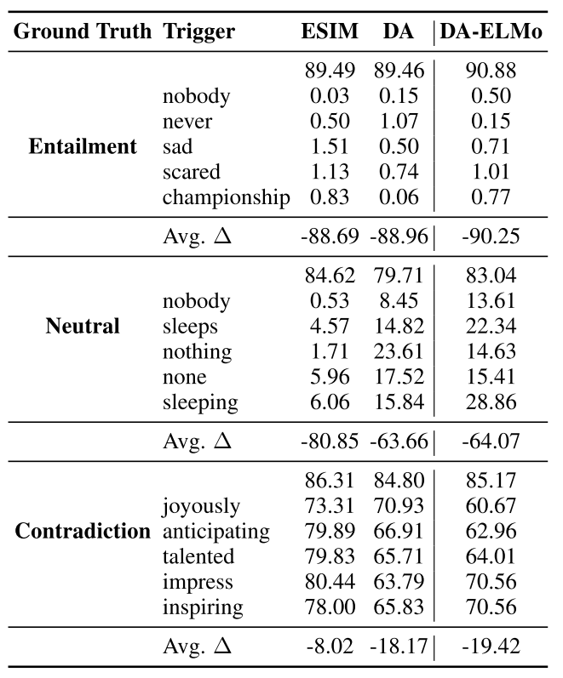
Result on SNLI

Slide 11
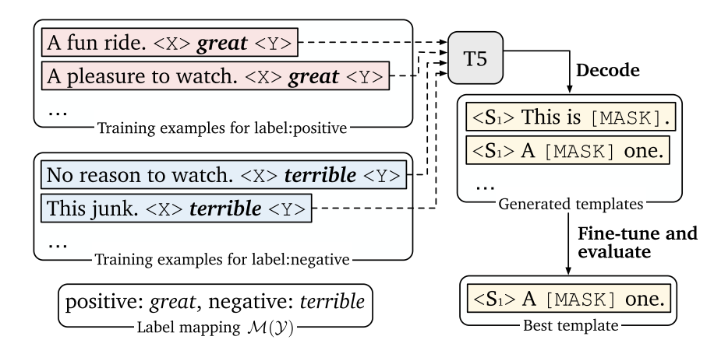

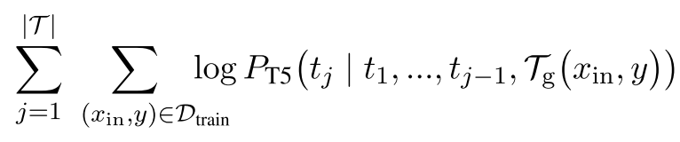
Automated Template
Making Pre-trained Language Models Better Few-shot Learners, ACL 2021
Use pretrained seq2seq model into template search process
=
Decode with beam search width 100 to get a large set of diverse templates
Fine-tune on training set and evaluate on development set

Slide 12
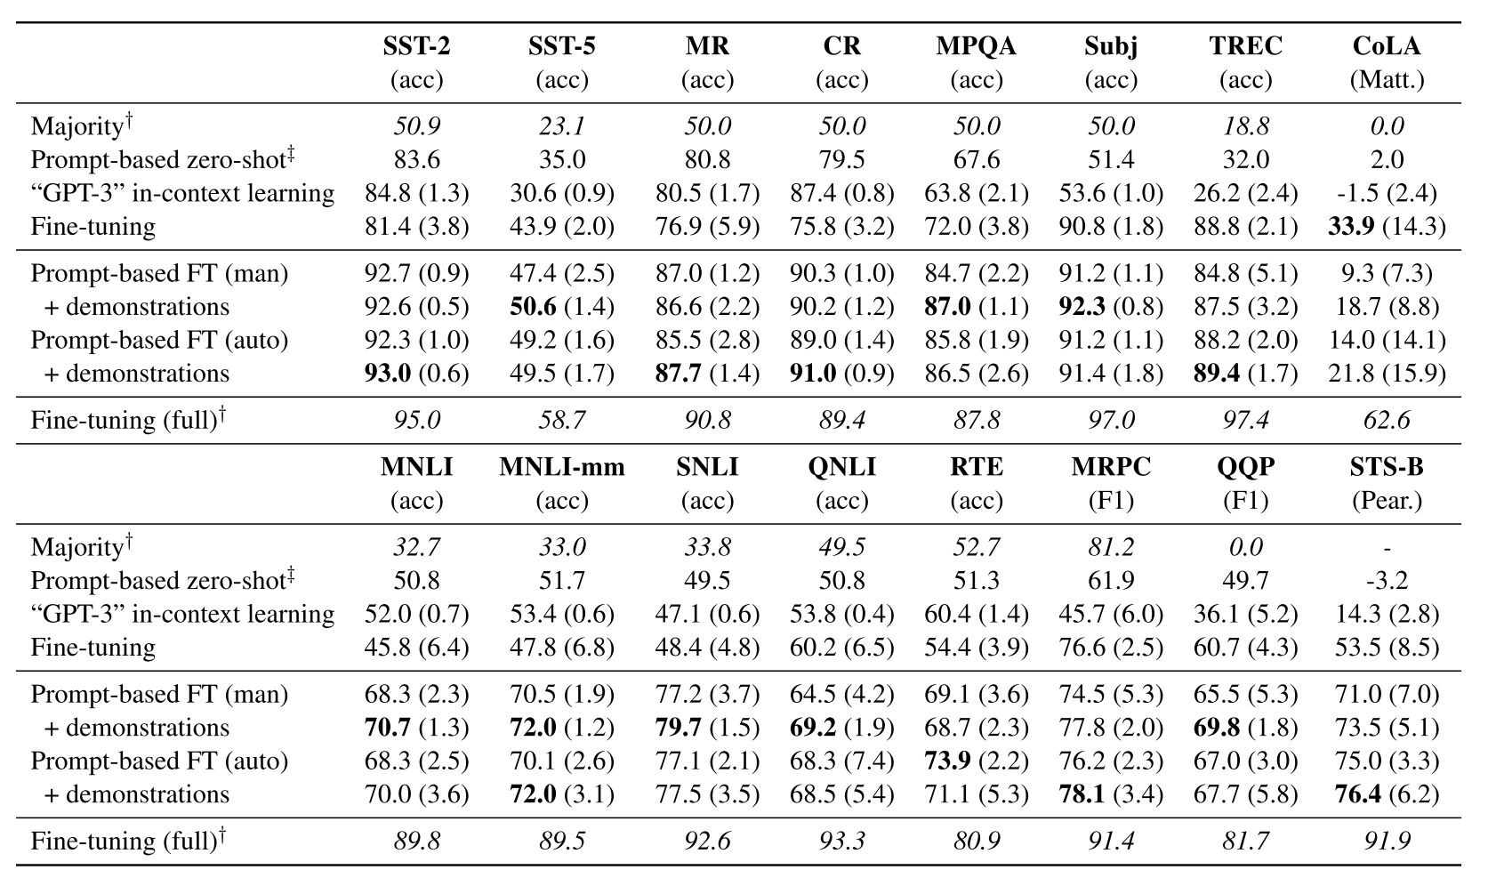
Automated Template
RoBERTa-large, few-shot(16 examples per class)

Slide 13
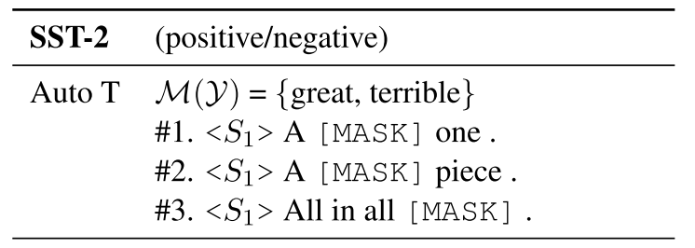
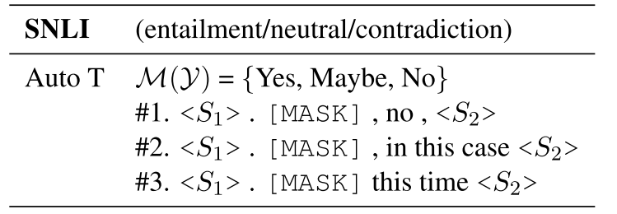
Automated Template

Slide 14
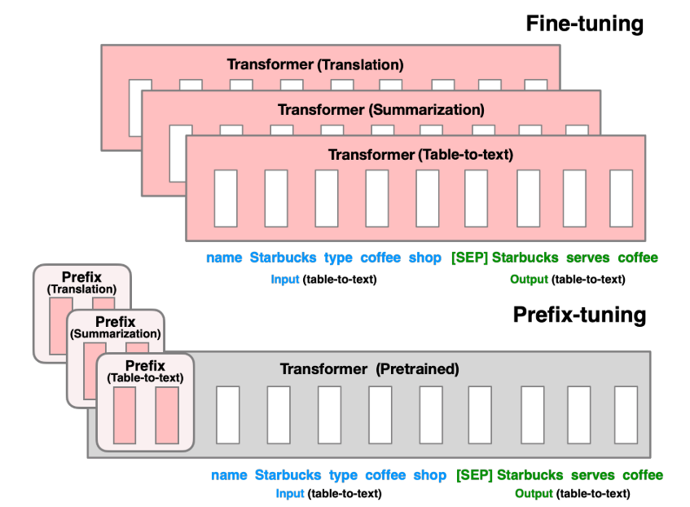

Automated Template
Prefix-Tuning: Optimizing Continuous Prompts for Generation, arXiv, 2021
Use continues prompt instead of discrete prompt
Prefix can be initial randomly or with discrete prompt

Slide 15
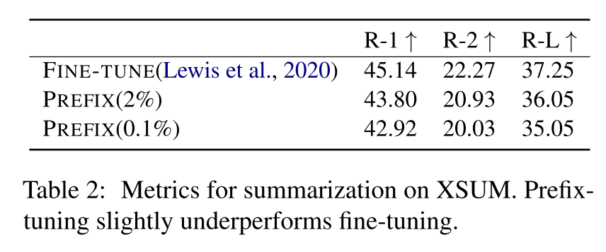
Automated Template
“2%” means only using 2% trainable parameters

Slide 16
Multi Prompts
Exploiting Cloze Questions for Few Shot Text Classification and Natural Language Inference, EACL, 2020
Combine multi prompts in a knowledge distillation way

Slide 17
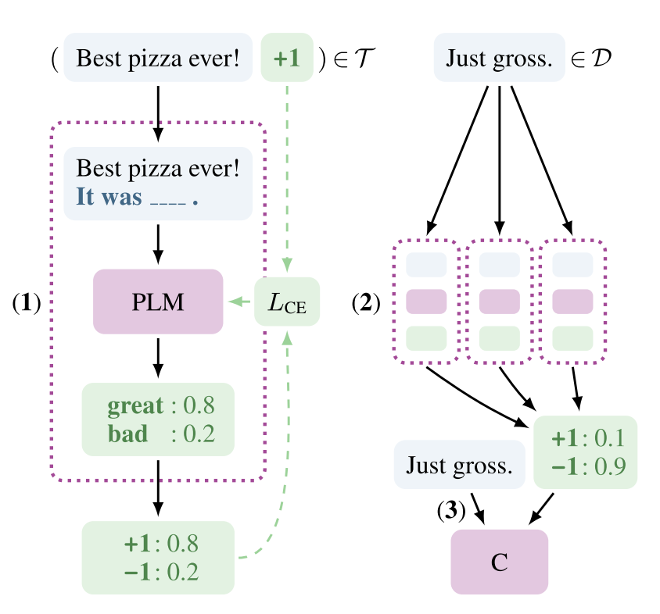
Multi Prompts
PLM fine tuned on different prompts
Use ensemble model to label the unlabeled data
Train a new classifier
Notes:
The ensemble model usually outperforms than the trained classifier

Slide 18
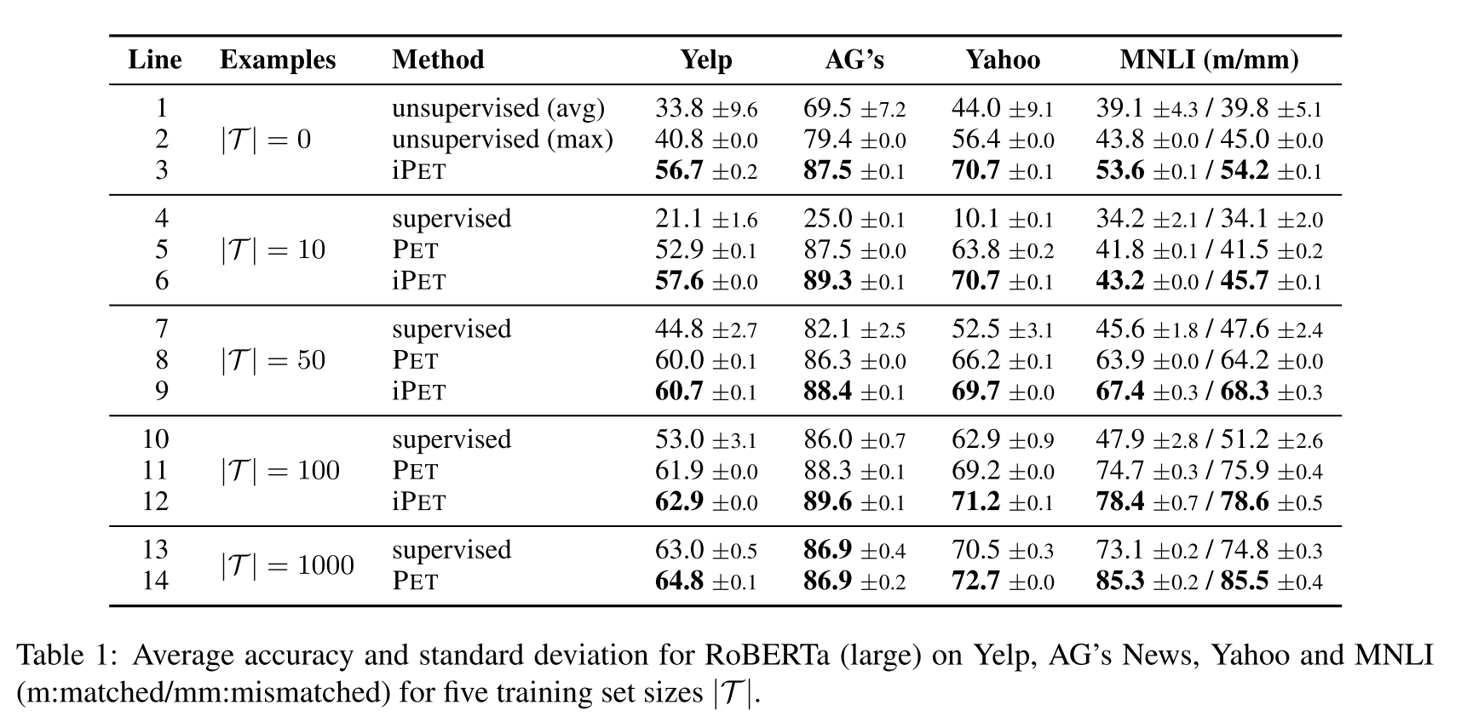
Multi Prompts

Slide 19
Conclusion
Prompt based-learning is better than fully supervised model in zero-shot and few-shot settings
However, how to design a suitable prompt is still a problem

Slide 20
Thanks

